Slide 1
Normalisation
Good design and its verification

Slide 2
How do we identify/design tables
Why did we have 2 tables in the Whole Picture exercise?
  Seems right?
Given a big and/or complex system
  how would we identify/design the tables?
  how would we know we had made good decisions?
c.f. how do we choose classes

Slide 3
Normalisation
Improving the design of relations
Just because the data are in a table with atomic entries does not make it an effective or appropriate structure
  Changing data in a table can have undesirable consequences
    Modification Anomalies
  We may have duplicated data
    inefficient
    two copies means one is wrong ☺

Slide 4
Informal Characterisation of Normalisation
  Relations should be about just one thing each
  Trying to do two things with one relation will cause problems
    We may not realise we have two things there
  Normalisation is the process of recognising and breaking up “compound” relations
  You once thought the two things were one
    They probably have a relationship which referential integrity could support

Slide 5
Modification Anomalies
Modification anomalies can be avoided by redefining a relation into two or more relations
  This is a loss-less decomposition
  There is no less (or more) data than before
    But it is held in a better way
The redefined relations probably have referential integrity constraints

Slide 6
Modification Anomalies
Deletion anomaly
  When we delete something, we lose other information
Insertion anomaly
  When we wish to insert something, we are unable to, because an additional fact is also required
Update anomaly
  When we wish to update (alter) something we find that it appears more than once

Slide 7
Modification Anomaly Examples
Worth exploring examples
Kroenke
  6th edition, p115
  7th edition, p118
Connolly & Begg (DB Soln^{s})
  pp103-105
Connolly & Begg (DB Sys^{s})
  pp193-195

Slide 8
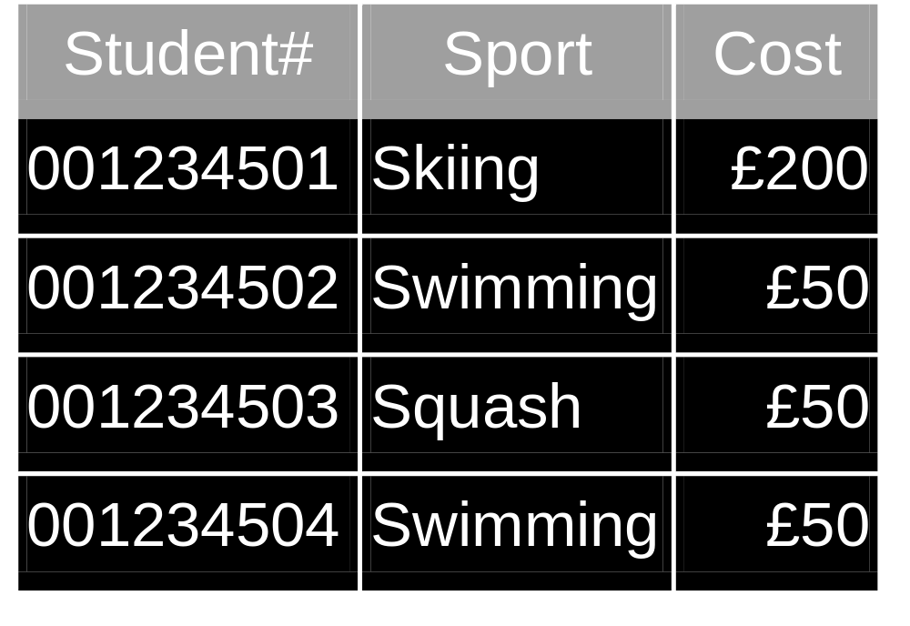
Kroenke Example (modified)
Deletion Anomaly
What happens if 001234501 stops skiing?
Not Normalised
Update Anomaly
What happens if Swimming goes up to £60?
Insertion Anomaly
What happens if rugby is added at £75?

Slide 9
Detecting modification anomalies
The update anomaly is perhaps the most obvious
  If one fact is copied lots of times the design “feels” wrong
  Many beginners would notice this
Deletion and insertion anomalies are perhaps less obvious
  But prove a real problem later in the life of the system
    During implementation – bad
    During use – worse

Slide 10
Normalisation Techniques
We will think up relations, based on our problem area
We need to check than they are good relations
  Splitting any which have problems and checking again
How do we check?

Slide 11
Consider two techniques
First to fifth normal form
  Progressive normalisation
    Follows historical theoretical analysis and avoidance of anomalies
    Very widespread use
    “open ended”
Domain/Key normal form
  A newer concept
    Complete
      A relation on DK/NF has no modification anomalies
    No known algorithm for reducing a relation to DK/NF

Slide 12
Normal Forms
Largely hierarchical
  A relation is in a particular form if it is in the preceding form and…
1NF
2NF
3NF
BCNF (Boyce-Codd)
4NF
5NF

Slide 13
First Normal Form – 1NF
Anything which meets the definition of a relation
  q.v.
common problems include:
  multiple valued entries
  an attribute with mixed values
    domain not defined
C&B DB Soln^{s}, pp106-107
C&B DB Sys^{s,} pp199-202, 212-213

Slide 14
Second normal form
“A relation is in 2NF if and only if it is in 1NF and every non-key attribute is irreducibly dependent on the primary key” (Date)
  We must not have a functional dependency based on part of the primary key (partial dependency)
    this can only apply to relations with compound PKs
    with a single attribute PK a relation is in 2NF
      if it’s in 1NF
  We can split up relations with this problem

Slide 15
2NF examples
Kroenke
  6th edition, p118
  7th edition, p120
C&B, DB Soln^{s}
  pp 107-111
C&B, DB Sys^{s}
  pp203-205, 214-215

Slide 16
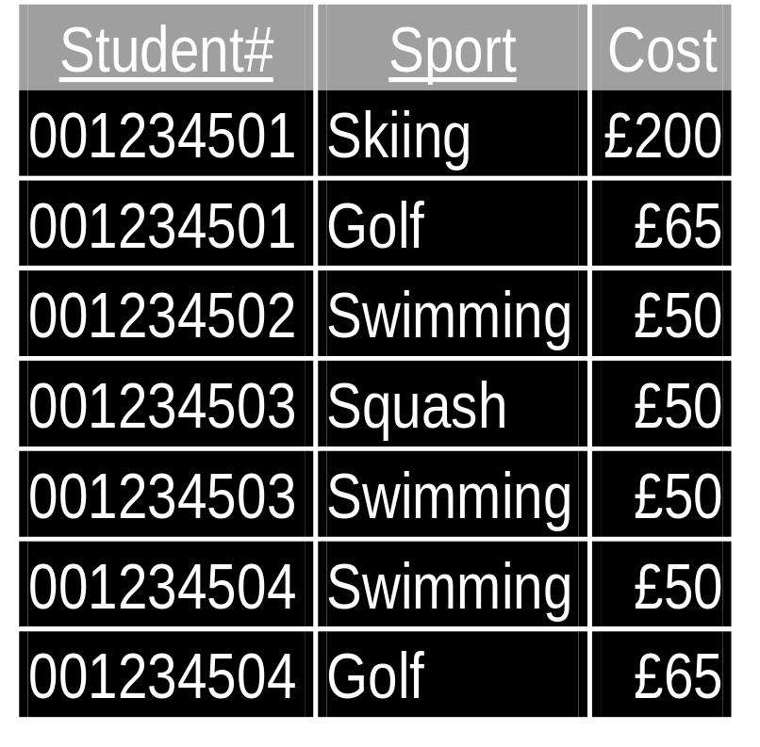
Kroenke 2NF example (modified)
Compound PK
Why?
Which mod. anomalies?
Describe the 2 ideas
What is the partial dependency?
Sport ➔ Cost

Slide 17
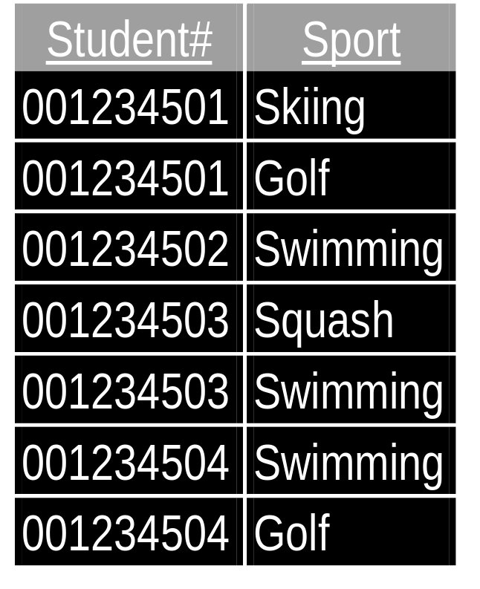
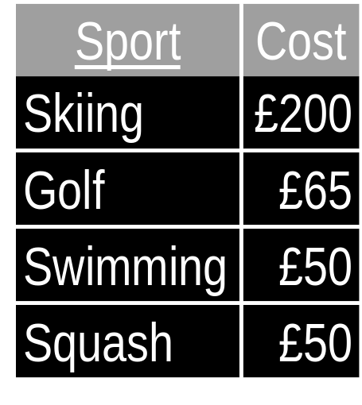
A split to remove the problem
“What things cost”
“Who does what”

Slide 18
2NF recommendation
Given
  R (A,B,C,D); Primary key (A,B); A ➔ D
We can replace R by two projections R₁ and R₂
  R₁ (A, D); Primary key (A); A ➔ D
  R₂ (A,B,C); Primary key (A,B); Foreign key (A) references R₁
We can recover R with the foreign to primary key join of R₁ and R₂

Slide 19
Third normal form
“A relation is in 3NF if and only if it is in 2NF and every non-key attribute is non-transitively dependent on the primary key” (Date)
  If A ➔ B and B ➔ C then A ➔ C
    C is transitively dependent on A
    If we delete a tuple we loose not only the A ➔ B information but perhaps also the B ➔ C (deletion)
    If we want to add a B ➔ C information tuple, we cannot without A ➔ B information (insertion)
We can split up relations with this problem

Slide 20
3NF Examples
Kroenke
  6th edition, p119
  7th edition, p121
C&B, DB Soln^{s}
  pp111-115
C&B, DB Sys^{s}
  Pp205-208, 215-216

Slide 21
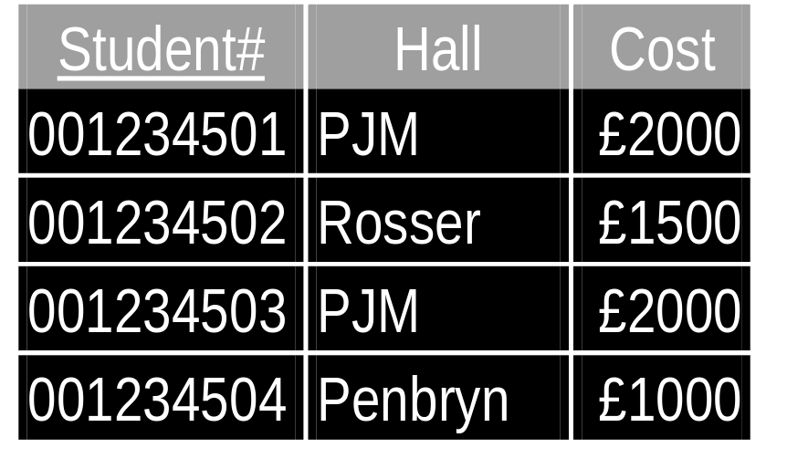
Kroenke 3NF example (modified)
What mod. anomalies
Describe the 2 ideas
What are the FDs?
Student#➔Hall
Hall➔Cost
Transitive dependency
Student#➔Hall➔Cost

Slide 22
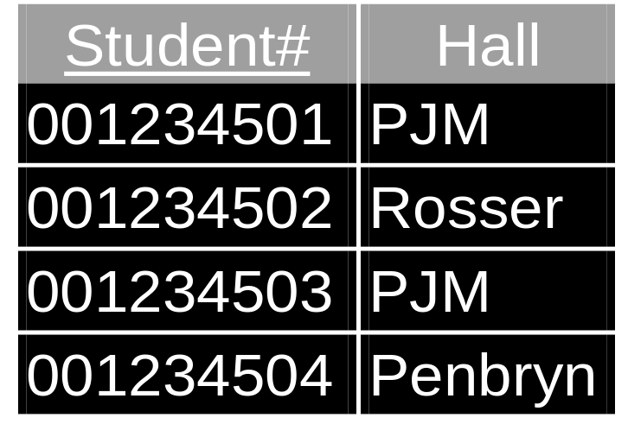
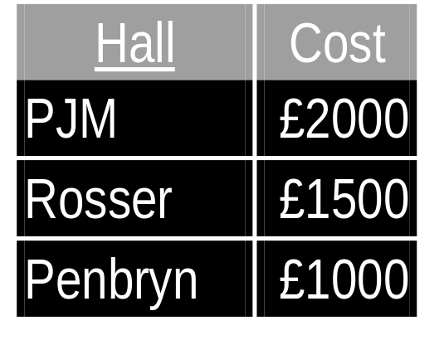
Kroenke 3NF example cont...
“Who lives where”
“What it costs to live where”

Slide 23
3NF recommendation
Given
  R (A,B,C); Primary key (A); B ➔ C
We can replace R by two projections R₁ and R₂
  R₁ (B,C); Primary key (B); B ➔ C
  R₂ (A,B); Primary key (A); Foreign key (B) references R₁
We can recover R with the foreign to primary key join of R₁ and R₂

Slide 24
Boyce/Codd Normal Form
“A relation is in BCNF if every determinant is a candidate key” (Kroenke)
  assumes minimal determinants and non-trivial FDs
  the only ➔ come from candidate keys
    therefore no FDs can be eliminated by normalisation

Slide 25
Why BCNF?
3NF did not treat the general case
did not deal with relations having 2 (or more) candidate keys where
  the two candidate keys are composite
  they have attributes in common (overlap)
BCNF
  Is conceptually simpler
  Is stronger
    Makes no reference to 1NF or 2NF

Slide 26
BCNF Examples
Kroenke
  6th edition, p120
  7th edition, p122
C&B DB Sys^{s}
  pp209-211, 216-217

Slide 27
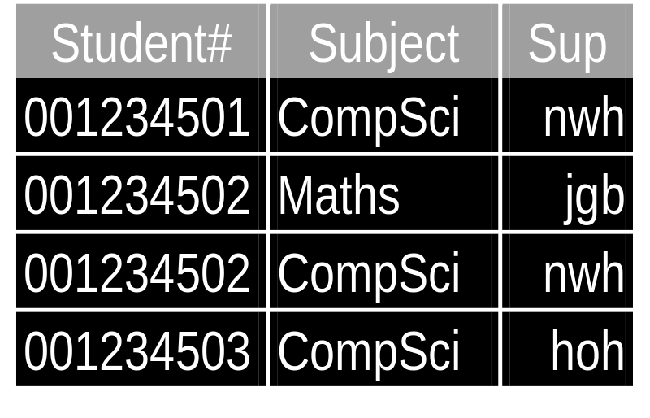
Kroenke BCNF example (mod)
Single and joint honours students, with supervisors
Student may therefore have one or two supervisors
Supervisors only supervise in one subject

Slide 28
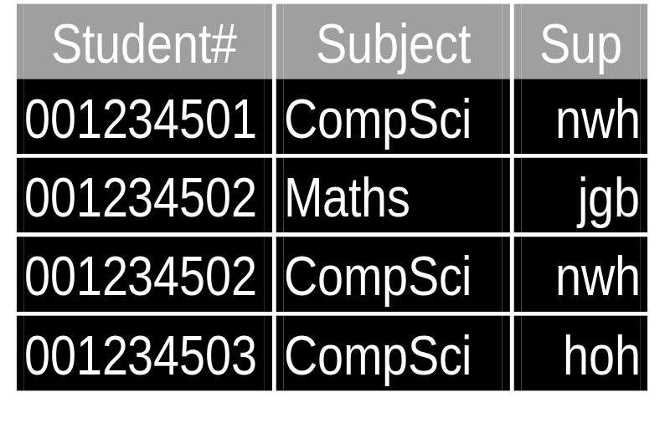
BCNF example cont...
S(Student#,Subject,Sup)
Sup ➔ Subject
“If you know the supervisor you know the subject”
CK {Student#,Subject}
  “If you know the student and subject, you know who supervises him/her for it”
CK {Student#,Sup}
  “If you know the student and the supervisor, you know which subject is concerned”

Slide 29
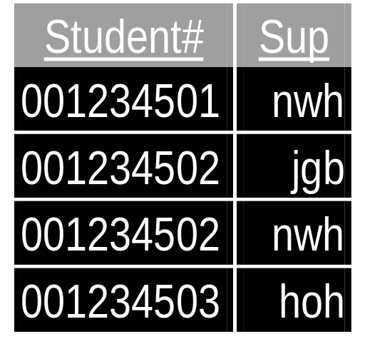
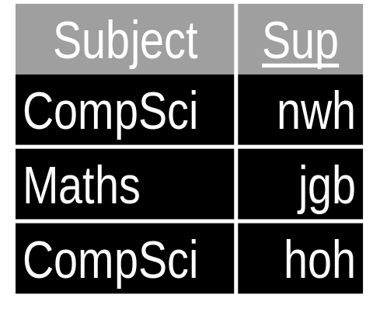
BCNF example cont...
We have:
  2 candidate keys
  they overlap on Student#
and
  we have a determinant which is not a PK
  sup
Therefore make that determinant a PK

Slide 30
Higher Normal Forms
A relation in BCNF has no modification anomalies associated with FDs
It was found not to be the end of the story however
  4NF and 5NF were necessary from a theoretical viewpoint
  rarely used
  we will not expect them
C&B DB Sys^{s}
  pp 217-221

Slide 31
Multi-value dependency
Problems removed in 4NF
A ➔➔B means
  A does not uniquely determine B
  The set of possible values of B is determined by A alone
A multi-value dependency exists in R (A,B,C) if
    A ➔➔ B
    A ➔➔C
    B and C are independent

Slide 32
Multi-value dependency problems
Implies an incorrect dependency between B and C
Another element of the set of B values determined by a value of A cannot be added alone

Slide 33
Join Dependencies
Relations requiring decomposition into more than 2 projections
Can cause problems in recovery
5NF tackles this

Slide 34
Domain/Key Normal Form
Fagin, 1988
In DK/NF if every constraint on the relation is a logical consequence of the definition of keys and domains
In DK/NF if enforcing key and domain rules causes all other constraints to be met

Slide 35
Domain/Key Normal Form
Requires creativeness
Probably reflects what we do as we get more experienced
Best illustrated by examples
Kroenke (with modifications)
  6th edition, p123
  7th edition. p126

Slide 36
DK/NF Example 1
STUD (ID,Status,Hall,Fee)
  Constraints
  ✶ ID must not start with “1”
  ✴ Hall ➔ Fee
Domains
  ID: “CDDD” (C ≠1)
  Status: {“UG”, “PG”}
  Hall: {“PJM”, “Rosser” …}
  Fee: Currency
STUD (ID, Status, Hall)
HALL (Hall, Fee)
✶
  Define a domain for ID
✴
  If Hall were a PK
  Can’t be PK of STUD
  Split the table

Slide 37
DK/NF Example 2
Staff (ID,Name,Module,SID,SName)
  Constraints
  ✶ ID ➔ Name
  ✴ Name ➔ ID
  → ID ➔➔ {Module, SID}
  ✵ Name ➔➔ {Module, SID}
   SID ➔ ID
   SID ➔ Name
   SID ➔ SName
   ID must start with "1"
   SID must not start with "1”
“Who teaches which modules and supervises which students”
ID and Name are equivalent
SID and SName are not
What concepts have we?
  1 ID/Name of staff
  2 Who teaches what
  3 Who supervises who

Slide 38
DK/NF Example 2 cont...
Staff (ID,Name,Module,SID,SName)
  Constraints
  ✶ ID ➔ Name
  ✴ Name ➔ ID
  → ID ➔➔ {Module, SID}
  ✵ Name ➔➔ {Module, SID}
   SID ➔ ID
   SID ➔ Name
   SID ➔ SName
   ID must start with "1"
   SID must not start with "1”
Domains
  ID: “1DDD” 
  SID: “CDDD” C≠1 
  …
1 STAFF (ID, Name)
✶ ()
2 TEACHES(Module, ID*)
→ ()
3 SUPERVISES (SID,Sname, ID*)  () 

Slide 39
DK/NF Example 3
ADVISE(SID,SNAME,ID,Name,Status)
  Constraints
  ✶ ID ➔ Name
  ✴ Name ➔ ID
  → ID ➔ Status
  ✵ Name ➔ Status
   Status
    "UG" supervise undergrads
    "PG" supervises postgrads
   ID must start with "1"
   SID of postgrads starts with "9"
Concepts
  1 Staff, name, status
  2 Undergrad supervision
  3 Postgrad supervision

Slide 40
DK/NF Example 3
ADVISE(SID,SName,ID,Name,Status)
  Constraints
  ✶ ID ➔ Name
  ✴ Name ➔ ID
  → ID ➔ Status
  ✵ Name ➔ Status
   Status
    "UG" supervise undergrads
    "PG" supervises postgrads
   ID must start with "1"
   SID of postgrads starts with "9"
Domains
  ID: “1DDD”
  PGID: “9DDD”
  UGID: “CDDD” (C ≠ 1, C ≠ 9)
  Status: {“UG”, “PG”}
  ...
STAFF (ID, Name, Status)
PGSup (SID, SName, ID*)
UGSup (SID, Sname, ID*)
Forward ref: We can sometimes handle sub-types

Slide 41
DK/NF - comments
Not so automatic
Reflects the thinking of a good designer
Includes material not covered by 1-5NF

Slide 42
Normalisation is just
Common Sense?
Yes
But common sense can be automated
  if it can be formalised
1-3NF (plus DN/NF?) provides method for beginners

